Slide 1
ROBUST MEDIAN FILTERING DETECTION
SUBMITTED BY:
DEEPAK BATTU(15110040)
PRIYANKA KAJLA(17210073)

Slide 2
INTRODUCTION
We can easily manipulate the information present in a formation. Our visual system cannot perceive those small variations in image . We cannot easily distinguish a median filtered image from a original image
The detection of median filtering from a JPEG compressed image is difficult because typical filter characteristics are suppressed by JPEG quantization and block artifacts.
Many methods were proposed to solve this problem. One such method is MFR

Slide 3
Median filtering
The median filter is a nonlinear digital filteing technique, often used to remove noise from an image or signal. Such noise reduction is a typical pre-processing step to improve the results of later processing (for example, edge detection on an image). Median filtering is very widely used in digital image processing because, under certain conditions, it preserves edges while removing noise (but see discussion below), also having applications in signal processing.

Slide 4
Median filtered residual
image is median filtered and the obtained image is subtracted from the original image . This is called residue of the image
R(i,j) = X(i,j) – Y(i,j)
Where X is original image ,Y is median filtered image
Residue matrix is truncated so that the computation becomes easy
If R(i,j)>c then r(i,j) = c .
If R(i.j) < -c then r(i,j) = -c
If -c <R(i,j) <c then R(i,j) = r(i,j)
r(i,j) is the truncated residue
The choice of threshold(c) determines the effectiveness of algorithm

Slide 5
Markov chains
Markov chain is a type of Markov process that has either discrete state space or discrete index set (often representing time), but the precise definition of a Markov chain varies. For example, it is common to define a Markov chain as a Markov process in either discrete or continuous time with a countable state space (thus regardless of the nature of time),but it is also common to define a Markov chain as having discrete time in either countable or continuous state space (thus regardless of the state space).The second order markov chains are used to model the residue .

Slide 6
Markov chains
The residue is divided in to blocks of size 3x3 and transition probabilities are calucated for the image based on these blocks
Calculating the horizontal and vertical transition of the blocks probabilities as follows
P^{( h,v)} (Z2,Z1,Z0) = P[ r(i+h,j+v) = Z2 /r(i,j)=Z1 & r(i-h,j-k)=Z3]
Where (h,v) = [ (0,1) ,(1,1),(1,0),(0,0) ]
Z2,Z1,Z0 takes values in the range [-c,c]., r(i,j) is the truncated residual matrix
Z2,Z1,Z0 takes values in the range [-c,c]
P(Z2,Z1,Z0) = [P^{( 0,1)} (Z2,Z1,Z0)+ P^{( 1,0)} (Z2,Z1,Z0) +P^{( 1,1)} (Z2,Z1,Z0) + P^{( 0,0)} (Z2,Z1,Z0)]/4
Since each Z2,Z1,Z0 takes 2c+1 values feature of a single image contains (2c+1⁾³ Values

Slide 7
C_SVM
Support Vector Machine (SVM) is a discriminative classifier formally defined by a separating hyperplane. In other words, given labeled training data (supervised learning), the algorithm outputs an optimal hyperplane which categorizes new examples.
In machine learning, support vector machines (SVMs, also support vector networks) are supervised learning models with associated learning algorithms that analyze data used for classification and regression analysis.
features of two sets of 90% images are given as train data to the classifier and remaining 10% are used for testing
The performance of the (C_SVM) algorithm is determined by the area under curve and average decision error P_{e}
P_{e} is equal to Min( P _{fp} +P _{tp})/2 where P _{fp} is false positive and P _{tp}
is true positive

Slide 8
Algorithm
step 1: to obtain the residue of the image
step 2: truncating the obtained residue
step3: feature extraction using markov chains. calculating the transition probabilities in the residue
step4: extracted features of 90% of images using markov chains are used to train the c_svm classifier and remaining are used for testing
step5: calculating the error and (AUC)area under ROC

Slide 9
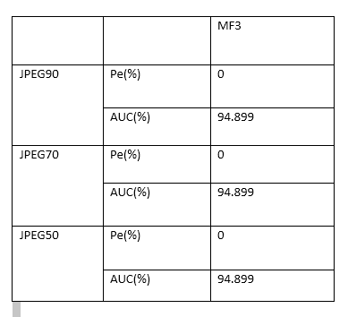
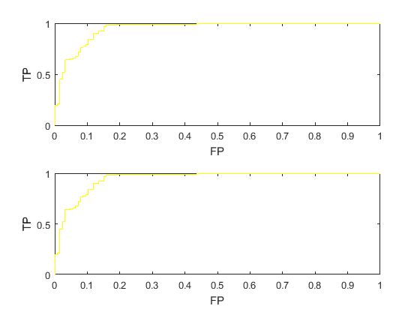
Result and graph

Slide 10
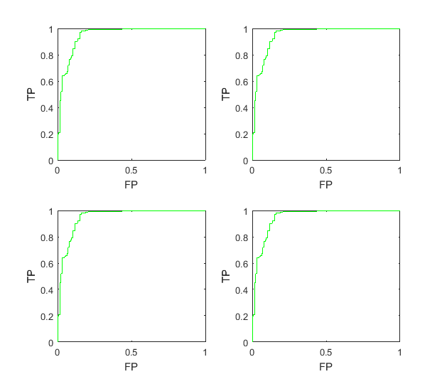
MF 5 comparison
The graph shows the results of detecting 3X3 median filtering image .
For normal image the error in detecting (pe) is low. For jpeg compressed images this error is larger but works very well compared to other methods

Slide 11
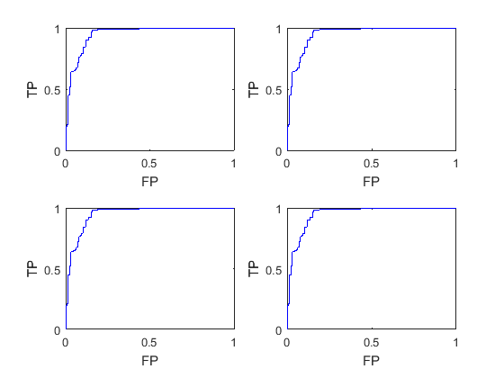
MF 3 comparison
The graphs shows the results of detecting a 5X5 median filtered image . The method works well for detecting
5x5 median filtered image compared to detecting 3x3 median filtered image

Slide 12
Conclusion
In MFPTR method the median filter residual to detect median filtering, which eliminate the interference from the image edge and texture.
Experimental results show the proposed method is very robust to JPEG post-compression even with quality factor as low as 50 and achieves much better performance than the existing methods
This method can also distinguish median filtering from other linear smoothers manipulation in the case of JPEG post compression. The developed method is suitable in forensics of image processing history
Can enhance security in resisting the anti-forensic attack.
The developed technique can be applied to detect compressive sensing compression and other signal manipulation.

Slide 13
References
1. Kirchner, M., Fridrich, J.: On detection of median filtering in digital images. In: Proc.
SPIE, Electronic Imaging, Media Forensics and Security II, vol. 7541, pp. 1–12 (2010)
2. Yuan, H.: Blind Forensics of Median Filtering in Digital Images. IEEE Trans. Inf. Foren-sics Security 6(4), 1335–1345 (2011)
3. Cao, G., Zhao, Y., Ni, R., Yu, L., Tian, H.: Forensic detection of median filtering in digital
images. In: Proc. 2010 IEEE Int. Conf. Multimedia and Expo. 2010, pp. 89–94 (2010)
4. Popescu, A.C., Farid, H.: Exposing digital forgeries by detecting traces of re-sampling.
IEEE Transactions on Signal Processing 53(2), 758–767 (2005)

Slide 14
Thank you

